Slide 1
Case 7
Woman vaccinated against HPV with cervical intraepithelial lesion
Dr. Javier Cortés

Slide 2
Reason for consultation
35 years of age. 2 children. Has an IUD in place since 4 years ago.
No relevant pathological history.
Visits for a gynecological exam.

Slide 3
Medical History
Stable sexual partner for last 7 years.
Previously, open sexual relations, always heterosexual, often without protection.
Annual gynecological exams, always with negative cytology.
Vaccinated with Gardasil 9® 14 months ago.
Action
A gynecologic examination is performed and a sample is obtained for HPV determination.

Slide 4
Results
Clinically normal gynecologic examination
HPV Determination: Positive for HR types not 16/18
Platform used: Cobas®4800 HPV Test.
Cytology indicated

Slide 5
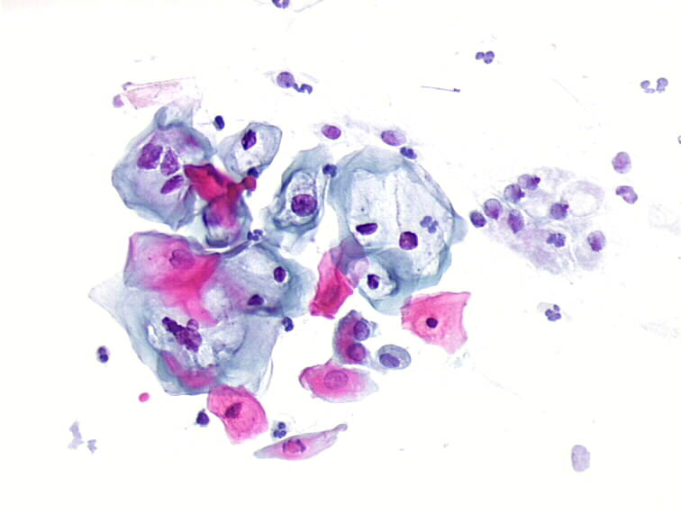
LSIL¹
COLPOSCOPY INDICATED²
1. https://screening.iarc.fr/atlasclassifbethesda.php
2. Oncoguía SEGO: Prevención del cáncer de cuello de útero [SEGO Oncoguides: Cervical cancer prevention]. Guías de práctica clínica en cáncer ginecológico y mamario [Practical clinical guidelines in gynecological and breast cancer]. Publicaciones SEGO, October 2014.

Slide 6
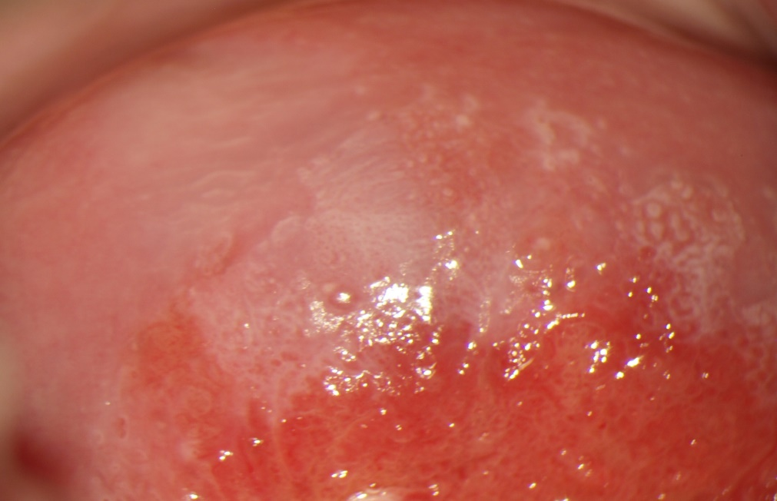
G1 Changes³
3. Bornstein J.: 2011 colposcopic terminology of the International Federation for Cervical Pathology and Colposcopy. Obstet Gynecol. 2012;120:166-72.

Slide 7
Action
No biopsy. Follow-up²
Recommended:
Treatment with Papilocare®.
New check-up in 6 months.
2. Oncoguía SEGO: Prevención del cáncer de cuello de útero [SEGO Oncoguides: Cervical cancer prevention]. Guías de práctica clínica en cáncer ginecológico y mamario [Practical clinical guidelines in gynecological and breast cancer]. Publicaciones SEGO, October 2014.

Slide 8
HPV vaccine efficacy data*
Discussion
HPV vaccination is strictly prophylactic, with no therapeutic effect on HPV infections present at the time of vaccination.
Gardasil 9®
Efficacy: 95% CI
CIN 2/3, AIS, Cervical Cancer, VIN 2/3, VaIN 2/3, Vulvar Cancer and Vaginal Cancer related to HPV 31, 33, 45, 52, 58:
97.4 (85.0; 99.9)
CIN 2/3, AIS related to HPV 16, 18:
98.2 (93.5; 99.8)
VIN 2/3 related to HPV 6, 11, 16, 18:
100.0 (67.2; 100.0)
VaIN 2/3 related to HPV 6, 11, 16, 18:
100.0 (55.4; 100.0)
Genital Warts related to HPV 6, 11, 16, 18:
99.0 (96.2; 99.9)
Cervarix®
Efficacy: 95% CI
CIN 2/3 Efficacy related to HPV 16, 18:
94.9 (87.7; 98.4)
CIN 2/3 related to:
HPV 31 87.5 (68.3;96.1)
HPV 33 68.3 (39.7;84.4)
HPV 39 74.9 (22.3;93.9)
HPV 45 81.9 (17.0;98.1)
HPV 51 54.4 (22.0;74.2)
Cervarix® https://cima.aemps.es/cima/dochtml/ft/07419006/FT_07419006.html
Gardasil 9® https://cima.aemps.es/cima/dochtml/ft/1151007002/FT_1151007002.html

Slide 9
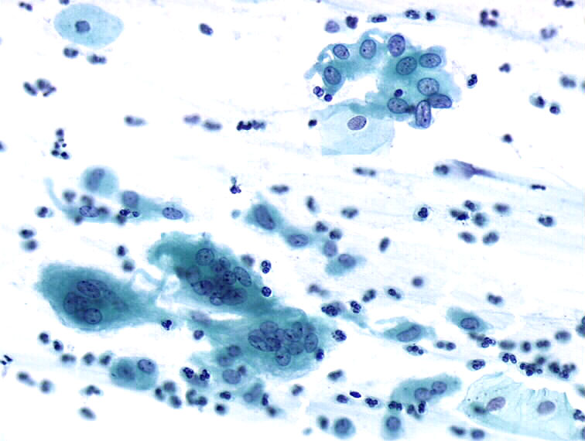
ASC-US
Discussion
Changes due to IUD
LSIL
https://screening.iarc.fr/atlasclassifbethesda.php

Slide 10
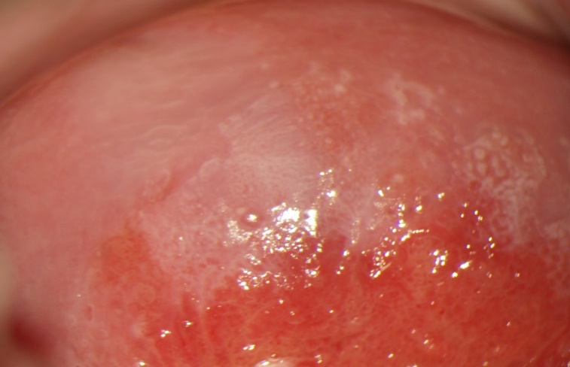
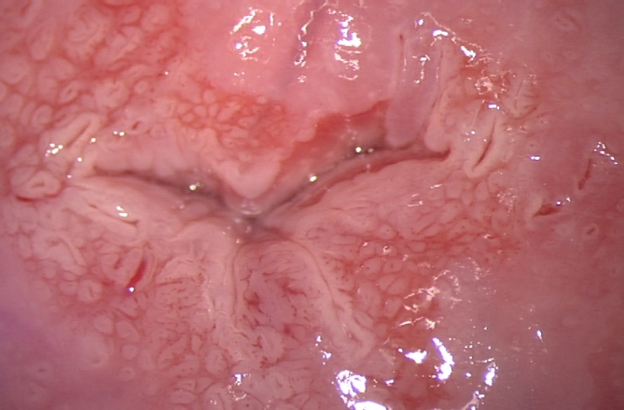
G2 Changes
Discussion
Normalcy
G1 Changes
3. Bornstein J.: 2011 colposcopic terminology of the International Federation for Cervical Pathology and Colposcopy. Obstet Gynecol. 2012;120:166-72.

Slide 11
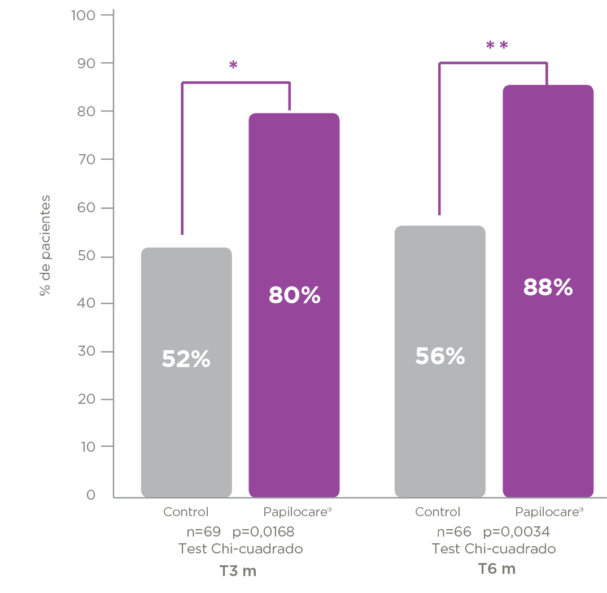
Discussion
CYTOLOGICAL NORMALIZATION LSIL / ASC-US AT 3 AND 6 MONTH
WITH CONGRUENT COLPOSCOPY
PAPILOCARE®
Paloma Clinical Trial*.
Final results
High-Risk HPV Sub-population
% of patients
n=69 p = 0.0168
Chi-squared test
T3 m
n=66 p = 0.0034
Chi-squared test
T6 m
Spontaneous regression to normalcy of LSIL: 59.1% at 2 years Matsumoto IJC 2011
*Serrano L et al. ASCCP 2020 Orlando

Slide 12
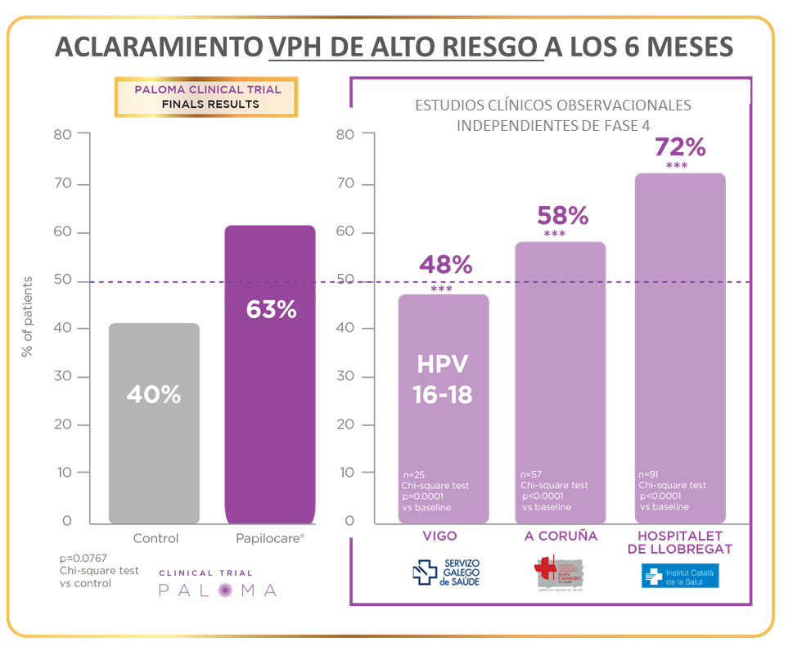
Discussion
HIGH-RISK HPV CLEARANCE AT 6 MONTHS
PALOMA CLINICAL TRIAL
FINAL RESULTS
INDEPENDENT PHASE 4 OBSERVATIONAL CLINICAL TRIALS
PAPILOCARE®
Paloma Clinical Trial.
Final results & independent studies
% of patients
PALOMA: Cortés J et al. ASCCP 2020 Orlando
VIGO: Gil Andrés M et al. ASCCP 2018, Las Vegas
CORUÑA: Gajino C. IPCV 2018. Sydney,
HOSPITALET: Riera M et al. J Low Genit Tract Dis. 2018.
HPV-HR Clearance: 29% at 6 months Bulkmans BJC 2007

Slide 13
Question 1
What is the preferred cervical cancer screening test?
Cytology.
HPV test.
Double test, cytology + HPV test.

Slide 14
Question 2
For a low-grade cytological lesion with congruent colposcopy, what action should be taken?
Biopsy.
Monitoring.
Monitoring with Papilocare® treatment and vaccination against HPV.

Slide 15
Question 3
After six months of follow-up, what rate of regression to normalcy can be expected for a low-grade lesion after treatment with Papilocare®?
88%.
68%.
48%.

