Slide 1
Case 8
HPV-induced genital lesions in a pregnant woman
Dr. Andrés Carlos López

Slide 2
Reason for consultation
Woman with condylomatous lesions who is 22 weeks pregnant.

Slide 3
Medical History
29 years of age. First pregnancy, 22 weeks pregnant.
History of genital warts (condyloma) 1 year ago.
Former smoker.
Not vaccinated against HPV.

Slide 4
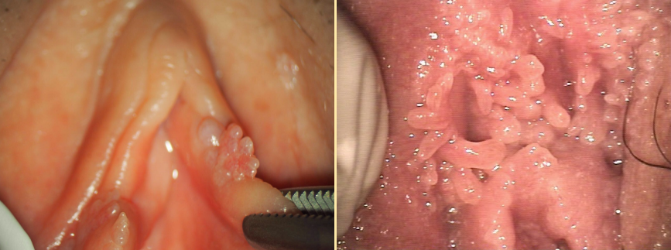
Action
A gynecologic examination is performed
Gynecologic examination

Slide 5
Results
Multiple exophytic lesions, of pink or white-gray color, on whose surface are visible filiform or papillomatous projections.

Slide 6
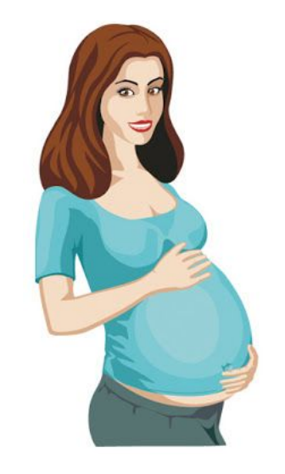
Treatment
The lesions are treated using cryotherapy.
Complete resolution of the picture.

Slide 7
Evolution
Subsequent check-ups with no evidence of recurrence.
Normal birth at week 39+3 with no complications.

Slide 8
Discussion
Condylomas are benign lesions caused by human papillomavirus (HPV) infection.
The HPV types responsible for 95% of condylomas are HPV type 6 and 11.
The lesions are generally asymptomatic. Depending on the number, size, and location, they can cause mild symptoms like itching, stinging, irritation or inflammation.

Slide 9
Discussion
Physiological and immunological changes in pregnancy may cause activation of HPV, which increases the incidence of condylomas in pregnant women, which can present in greater size and number than women who are not pregnant.
It is preferable to treat with a wait-and-see approach.
Treatment aims to reduce the viral load, peri-natal exposure and the proliferation of lesions that can hinder vaginal birth.

Slide 10
Discussion
The primary medical treatments are considered contraindicated. Podophyllotoxin has proven embryotoxicity.
Imiquimod and sinecatechins have little data available regarding safety in pregnancy.
The treatments of choice are excision, ablation, and trichloroacetic acid.

Slide 11
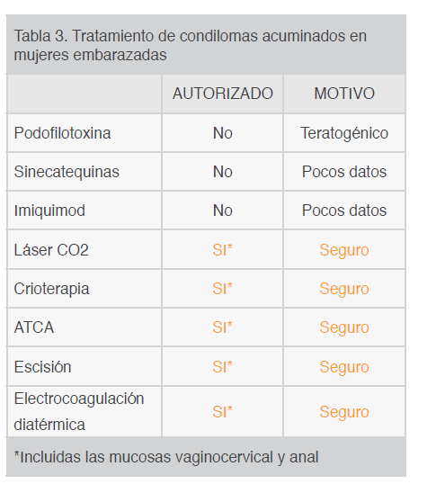
Conclusions
Table 3. Treatment of condylomata acuminata in pregnant women
 | AUTHORIZED | REASON
Podophyllotoxin | No | Teratogenic
Sinecatechins | No | Insufficient data
Imiquimod | No | Insufficient data
CO₂ Laser | Yes* | Safe
Cryotherapy | Yes* | Safe
Trichloroacetic Acid | Yes* | Safe
Excision | Yes* | Safe
Electrocoagulation Diathermy | Yes* | Safe
*Including vaginal-cervical and anal mucosa

Slide 12
Conclusions
Infection with HPV or the presence of condylomata acuminata during pregnancy does not cause fetal malformations.
Although there is an association between condylomas and laryngeal lesions in newborns, the risk of neonatal clinical problems or recurrent respiratory papillomatosis is very low and is not associated with a greater risk of peri-natal complications.
Therefore, the presence of genital warts during pregnancy is not a reason for a Cesarean, except when their size is such that they would obstruct the birth canal.

Slide 13
Question 1
Which are not indicated for the treatment of condylomas in pregnant women?
Imiquimod.
Cryotherapy.
CO₂ Laser.

Slide 14
Question 2
With regard to vertical transmission:
Infection with HPV is associated with fetal malformations.
The risk of respiratory papillomatosis is very high.
Vaginal birth is permissible if there is no obstruction of the birth canal.

Slide 15
Question 3
Condylomas in pregnancy:
Improve due to immunological changes.
Can reappear due to reactivation of HPV and yield larger lesions.
Should never be treated.

Slide 16
Recommended bibliography
Condiloma acuminado y embarazo. Consideraciones en la atención prenatal [Condylomata acuminata and pregnancy. Considerations in prenatal care]. Gac Méd Espirit [Internet]. 2015 Ago [cited 2020 Mar 10]; 17(2): 81–91.
Condylomata acuminata (anogenital warts): Treatment of vulvar and vaginal warts Uptodate Feb 2020.
Guía condilomas acuminados AEPCC 2015 [Spanish Association of Cervical Pathology and Colposcopy 2015 Guide to Condylomata Acuminata].
Human papillomavirus infections: Epidemiology and disease associations Uptodate Feb 2020.

